Slide 1
Energy Statistics in Denmark
2022

Slide 2
Gross energy consumption and emissions of CO₂
Index 1990=100
Adjusted

Slide 3
Degree of self-sufficiency

Slide 4
Primary energy production
PJ

Slide 5
Oil and gas reserves/resources

Slide 6
Natural gas consumption and flaring on platforms in the North Sea
PJ

Slide 7
Production of renewable energy by energy product
PJ

Slide 8
Consumption of waste
PJ

Slide 9
Consumption of renewable energy
PJ

Slide 10
Renewable energy – consumption by energy product
PJ

Slide 11
Use of renewable energy in 2022
PJ

Slide 12
Renewable energy - share of total energy consumption
%

Slide 13
Share of renewable energy according to the EU method of calculation
%

Slide 14
Wind power capacity and wind power’s share of domestic electricity supply
MW

Slide 15
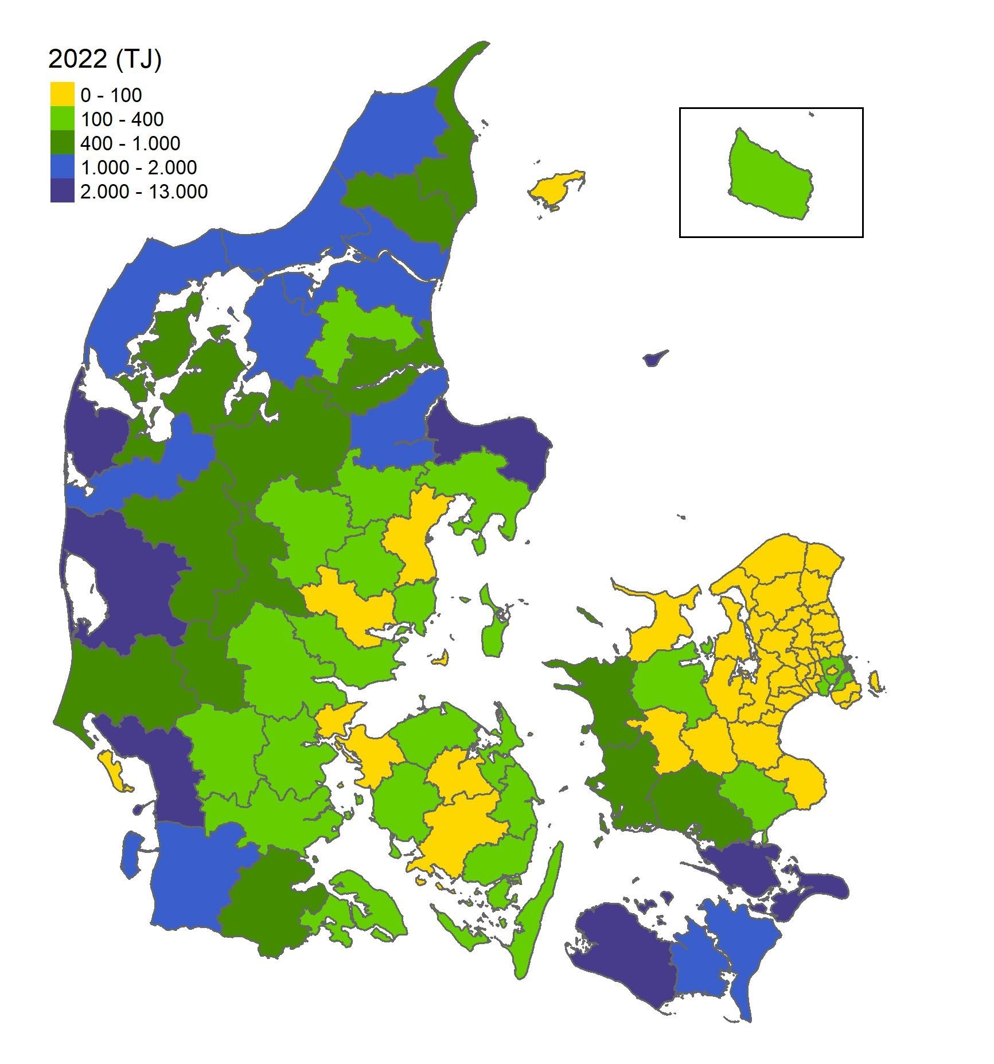
Wind power onshore by municipality 2022

Slide 16
Wind power capacity by turbine size
MW

Slide 17
Wind power production by turbine size
TJ

Slide 18
Electricity production by type of producer
PJ

Slide 19
Electricity production by fuel
PJ

Slide 20
Other fuels than coal for electricity production

Slide 21
Net exports of electricity by country
PJ

Slide 22
Electricity capacity
MW

Slide 23
CHP share of thermal power and district heating production

Slide 24
Heat supply 2022 by type of primary fuel
%

Slide 25
District heating production by type of production plant
PJ

Slide 26
Fuel consumption for district heating production, percentage distribution

Slide 27
Observed energy consumption and adjusted gross energy consumption
PJ

Slide 28
Gross energy consumption by fuel
PJ
Adjusted

Slide 29
Gross energy consumption by energy product after transformation
Adjusted
PJ

Slide 30
Gross energy consumption by use
PJ
Adjusted

Slide 31
Final energy consumption by use
Climate-adjusted
PJ

Slide 32
Final energy consumption by energy product
PJ
Climate-adjusted

Slide 33
Gross energy consumption and final energy consumption per DKK million GDP
TJ per DKK million GDP (2010 prices, chained values)

Slide 34
Final electricity consumption by use
Climate-adjusted
PJ

Slide 35
Electricity consumption’s share of total energy consumption
%
Climate-adjusted

Slide 36
Energy consumption for transport by type
PJ

Slide 37
Energy consumption for transport by fuel type
PJ

Slide 38
Energy consumption for road transport

Slide 39
Final energy consumption by passengers and freight transport
PJ

Slide 40
Energy consumption for passengers transport by means of transport
PJ

Slide 41
Energy consumption for freight transport by means of transport
PJ

Slide 42
Energy and electricity consumption in agriculture and industry
Climate-adjusted
PJ

Slide 43
Energy consumption in agriculture and industry by energy product
PJ
Climate-adjusted

Slide 44
Energy consumption by individual industry in the agriculture and industry sector
PJ
Climate-adjusted

Slide 45
Electricity consumption’s share of total energy consumption
Climate-adjusted

Slide 46
Energy and electricity consumption in manufacturing industry
Climate-adjusted
PJ

Slide 47
Composition of energy consumption in manufacturing industries
Climate-adjusted

Slide 48
Energy intensities in agriculture and industry
Climate-adjusted
TJ per million DKK GVA (2010 prices, chained values)

Slide 49
Electricity intensities in agriculture and industry
Climate-adjusted
TJ per million DKK GVA (2010 prices, chained values)

Slide 50
Energy consumption per employee in manufacturing industry
Climate-adjusted
GJ per employee

Slide 51
Energy and electricity consumption in the commercial and public services
PJ
Climate-adjusted

Slide 52
Energy consumption by energy product
PJ
Climate-adjusted

Slide 53
Composition of energy consumption in commercial and public services
Climate-adjusted

Slide 54
Energy consumption by sector
Climate-adjusted
PJ

Slide 55
Energy consumption for heating in the commercial and public services
PJ
Climate-adjusted

Slide 56
Electricity consumption by sector
Climate-adjusted
PJ

Slide 57
Energy intensities in the commercial and public services
Climate-adjusted
TJ per DKK million GVA (2010 prices, chained values)

Slide 58
Electricity intensities in commercial and public services
Climate-adjusted
TJ per DKK million GVA (2010 prices, chained values)

Slide 59
Energy consumption per employee in the commercial and public services
Climate-adjusted
GJ per employee

Slide 60
Energy consumption in households
PJ

Slide 61
Household consumption by energy types
Climate-adjusted
PJ

Slide 62
Energy consumption per household
Climate-adjusted
GJ

Slide 63
Heating installations in dwellings
1000 units

Slide 64
Energy consumption for heating in dwellings
Climate adjusted
Index 1990=100

Slide 65
Net energy consumption and heat loss for heating in dwellings
Climate-adjusted
PJ

Slide 66
Private consumption and electricity consumption in households
Index 1990=100

Slide 67
Household stock of electrical appliances
1000 units

Slide 68
Specific electricity consumption
of household appliances
kWh/year

Slide 69
CO2 emissions from energy consumption
Million tonnes CO₂

Slide 70
CO2 emissions by fuel
Adjusted
Million tonnes CO₂

Slide 71
CO2 emissions per fuel unit and per kWh electricity
Adjusted
Kilogram per GJ
Gram per kWh

Slide 72
Observed CO2 emissions by sector
Million tonnes CO₂

Slide 73
CO2 emissions in end-use of energy
Climate-adjusted
Million tonnes CO₂

Slide 74
Emissions of greenhouse gases
Million tonnes CO₂ equivalents

Slide 75
Total observed emissions from greenhouse gases distributed by origin 2021
* Waste deposit etc.: Waste deposit, Sewage treatment, Other waste and Indirect CO2-emissions

Slide 76
Observed net-emissions of green-house gases by origin
Million tonnes CO₂ equivalents
* Waste deposit etc.: Waste deposit, Sewage treatment, Other waste and Indirect CO2-emissions

Slide 77
Observed CO₂ emissions from energy consumption in 2022, EU ETS and non-EU ETS sectors
1000 tonnes

Slide 78
Energy expenses by industry and households
DKK Billion, current prices

Slide 79
Energy expenses in agriculture and industry
DKK Billion, current prices

Slide 80
Energy expenses by fuel
DKK Billion, current prices

Slide 81
Revenue from energy, CO2 and sulphur taxes
DKK Billion, current prices

Slide 82
Energy expenditures and tax revenues, fixed prices
Billion DKK, 2021 prices

Slide 83
Value of crude oil and natural gas production
Billion DKK, current prices

Slide 84
Exports of energy technology and equipment
Billion DKK, current prices

Slide 85
Spot market prices of crude oil
USD per barrel, annual average
*Prices for 2022 cover only the first six months.

Slide 86
CO₂-prices
EUR/tonne

Slide 87
Spot market prices for electricity
DKK 0.01 per kWh

Slide 88
Energy prices for households
DKK, current prices

Slide 89
Energy prices for households
DKK, 2022 prices

Slide 90
Electricity prices, excl. taxes for industrial customers
DKK per KWh
Source: Eurostat

Slide 91
Natural gas prices, excl. taxes for industrial customers
DKK per m³
Source: Eurostat

Slide 92
Motor gasoline prices
DKK per litre
Source: Oil Bulletin, European Commission

Slide 93
Composition of energy prices for households

Slide 94
Electricity prices for households* 1997-2022 (1 January)
DKK 0.01 per kWh
*Annual consumption of 4000 kWh

Slide 95
Natural gas prices for households 2018H1-2022H1
DKK per m³

Slide 96
Consumption of renewable energy
Exajoules

Slide 97
Oil consumption by region
Million tonnes

Slide 98
Energy consumption by region
Million tonnes oil equivalents

